Slide 1
Recyclotron
The bin that recycles for you

Slide 2
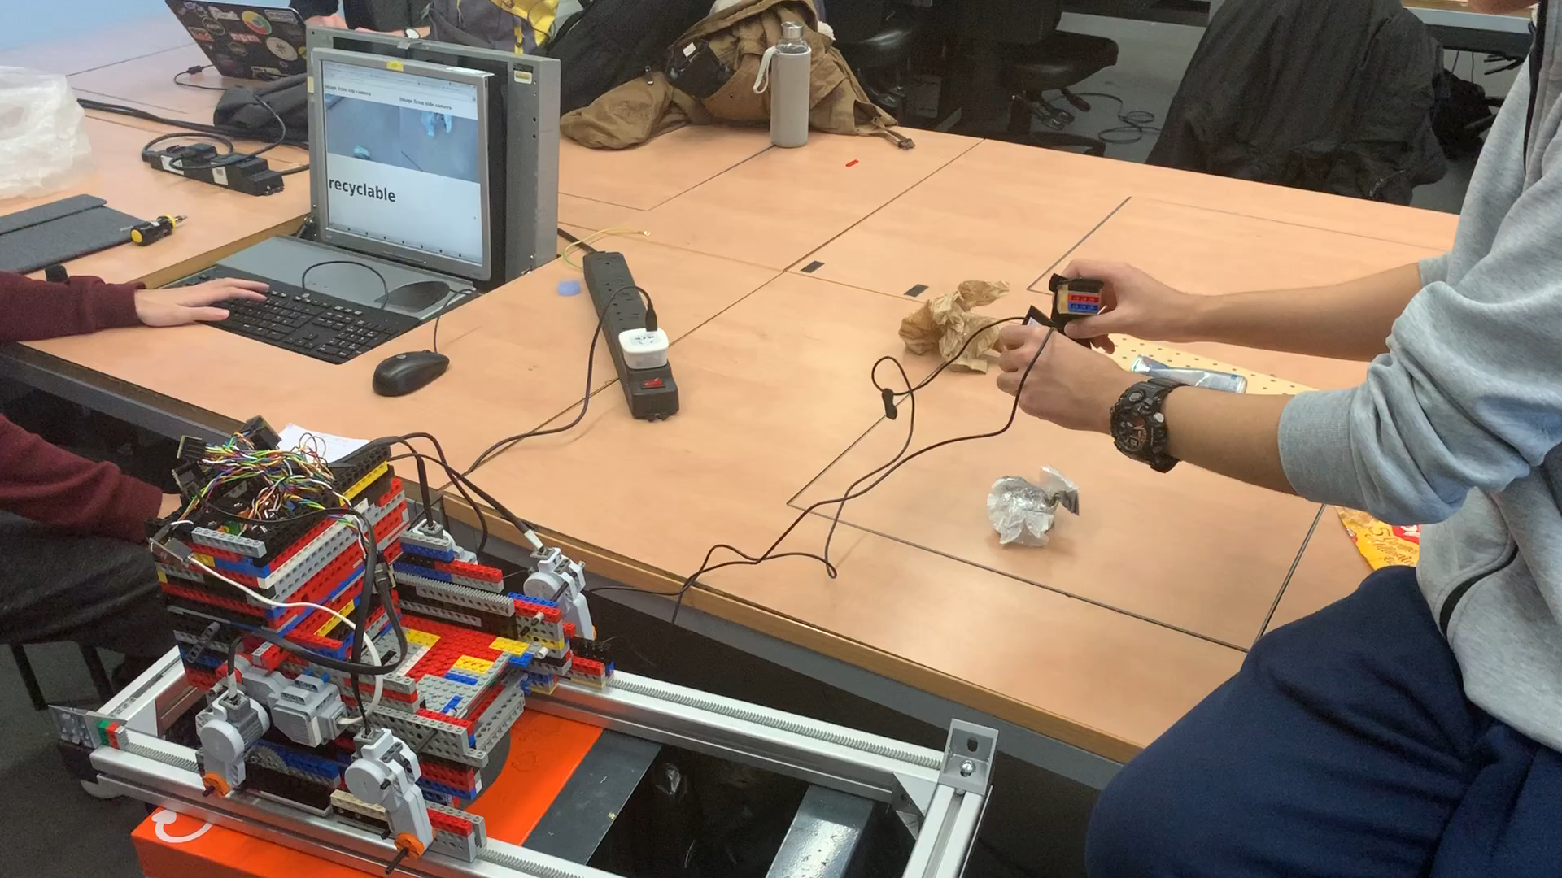
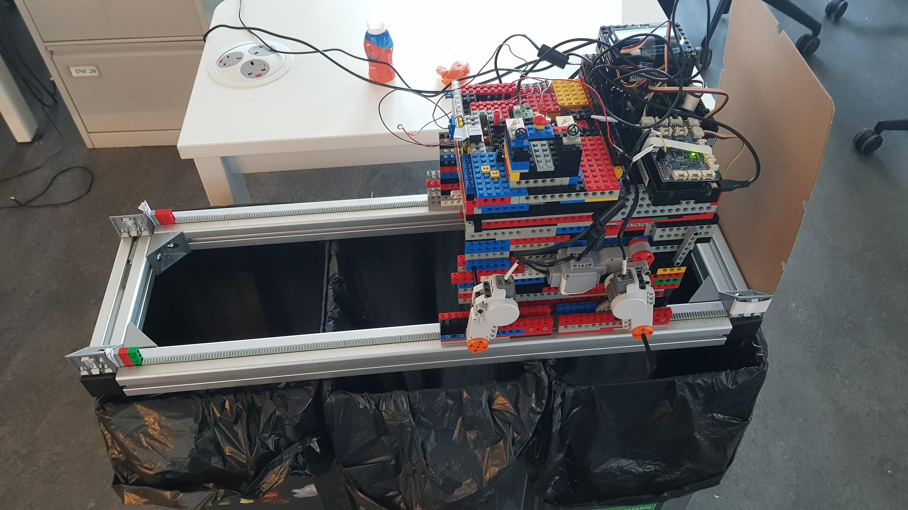
What is Recyclotron?
Recyclotron is a smart-bin that detects, identifies and sorts rubbish, reducing user interaction to one bin.
DEMO 1
DEMO 2
Notes:
These are high level goals

Slide 3
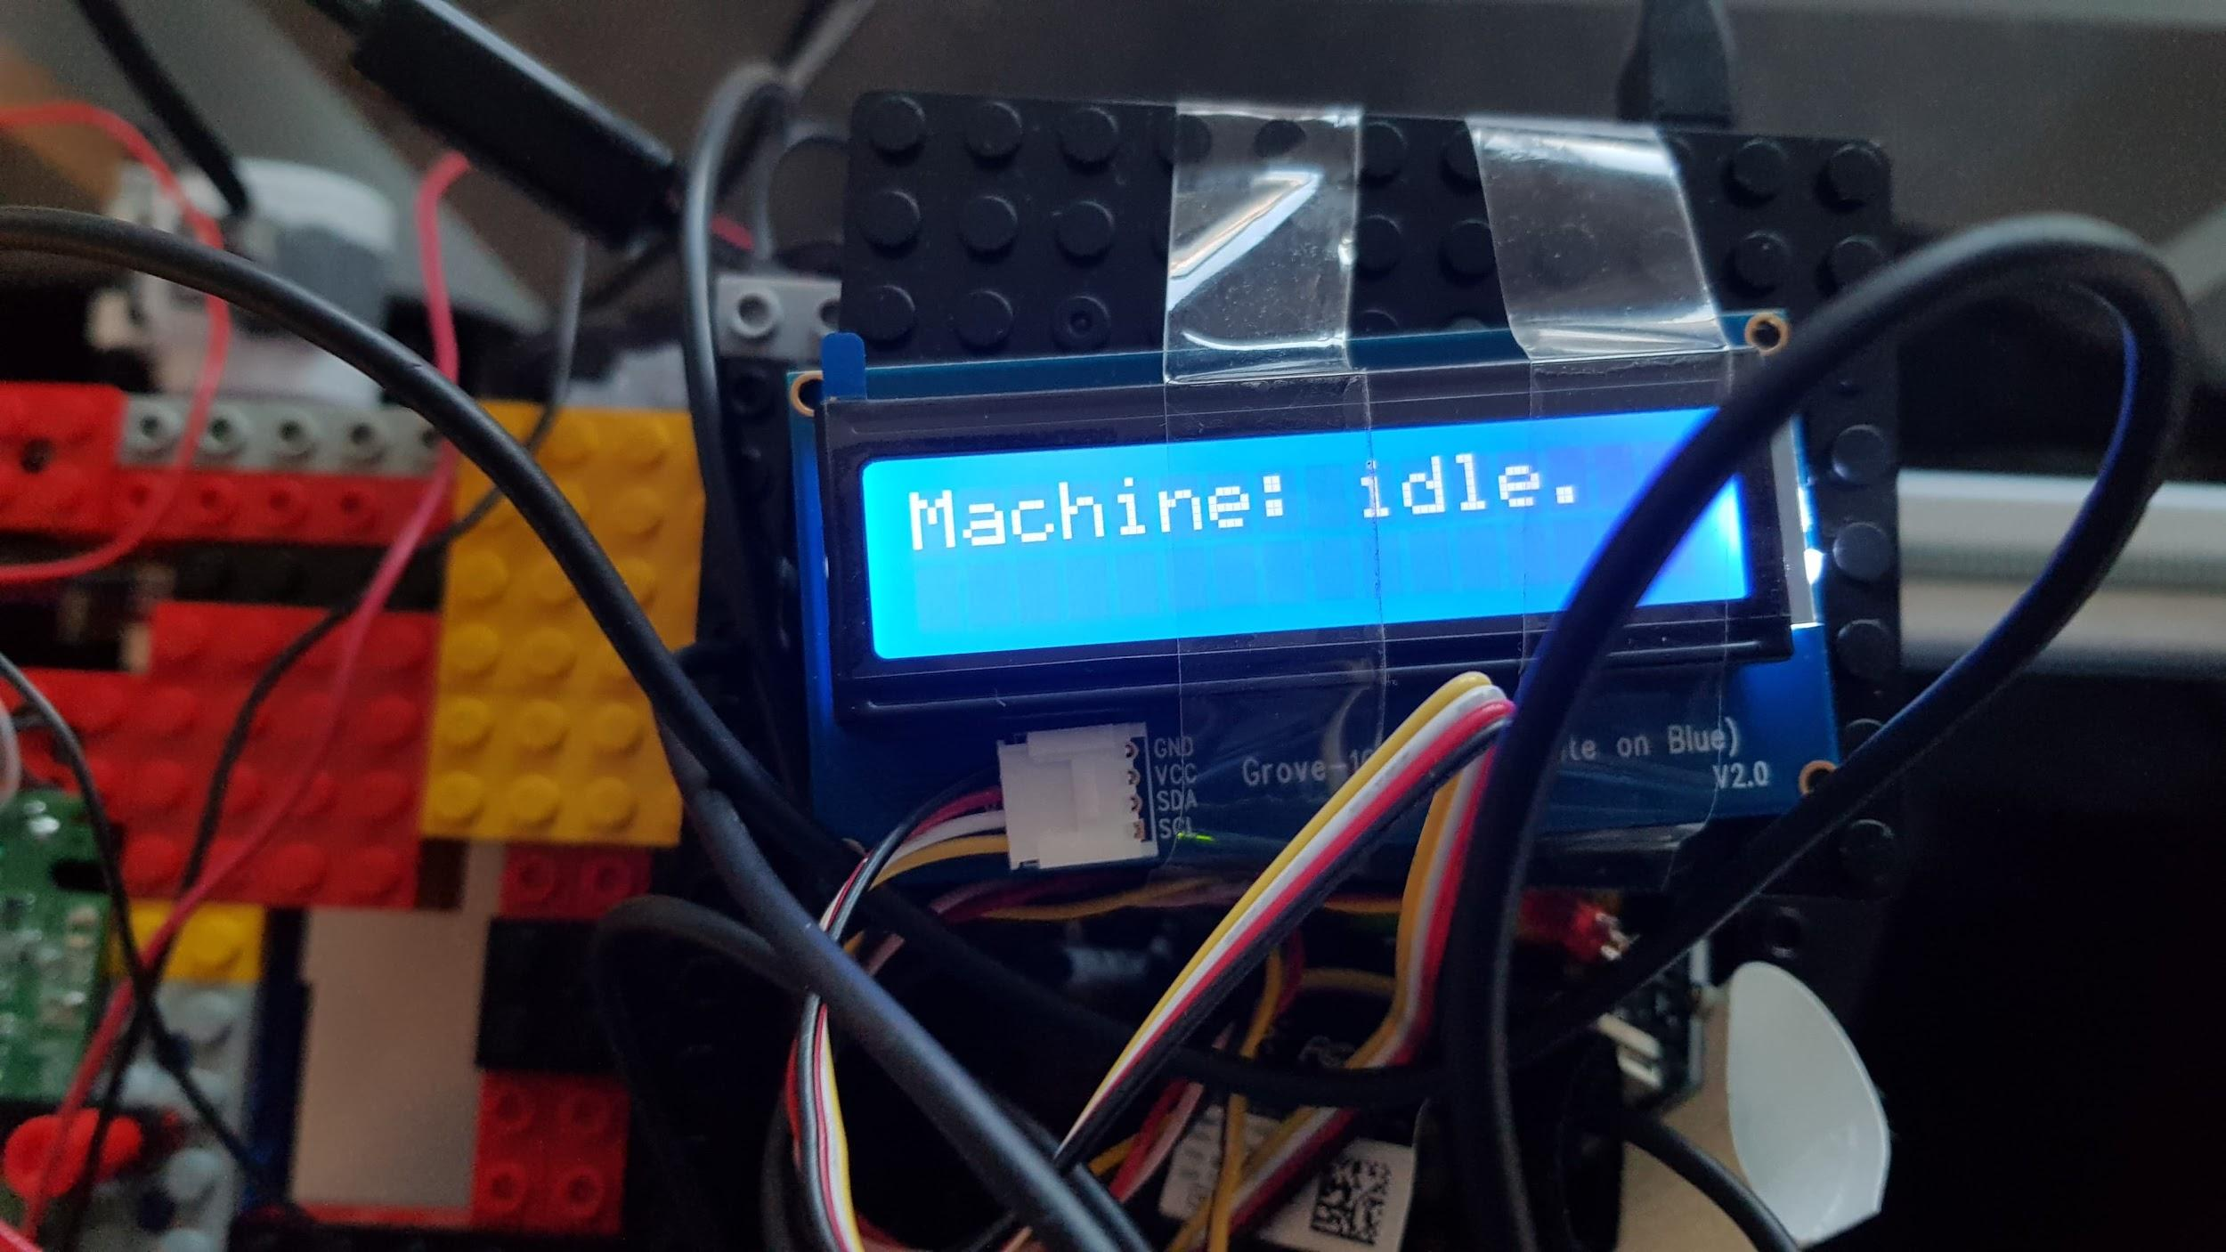
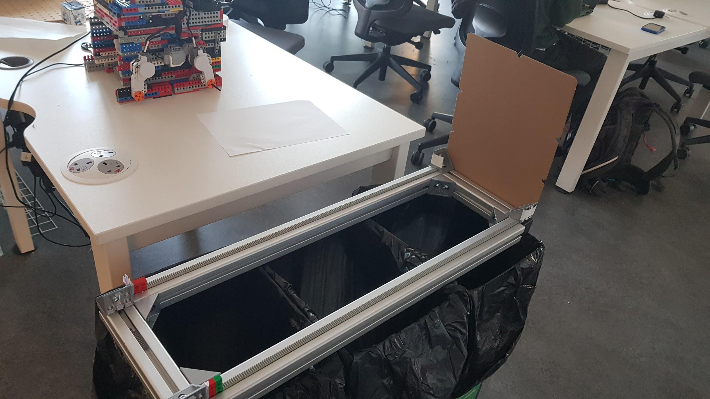
What we made for Demo 2
Added a lid to act as a trigger for detecting rubbish
3D printed a model for better structural stability
Added a screen to show clear feedback
Added ultrasonic sensors to track position
Extended the ML model to work with 3 and 4 bins
Improved the ML model with better datasets
Lid
Other Recyclable
Trash
Metal
Sensors
Notes:
We did it all! woo

Slide 4
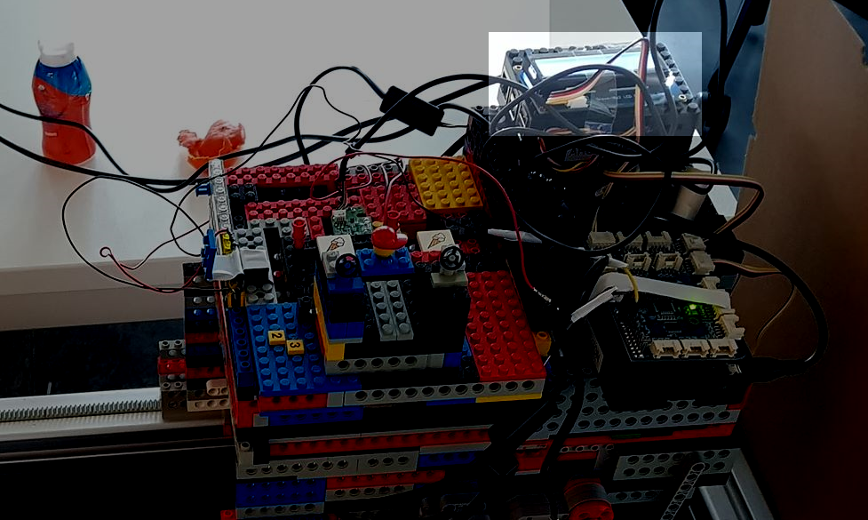
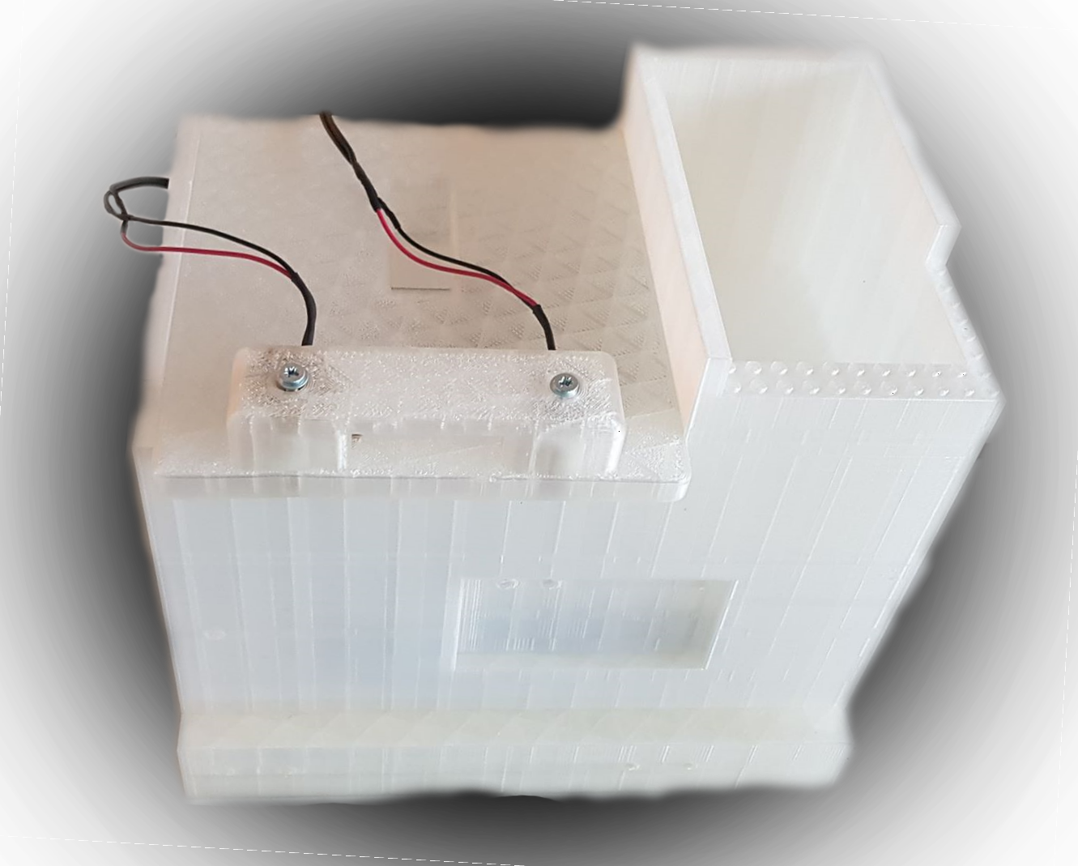
Problems with Demo 2
Feedback was passive and non-interactive
3D Printed model took too long to print & test
We had to use 2 Raspberry PIs (for motors and sensors)
No single metric to measure success rate of system
Paper and glass were poorly classified
 | Glass | Metal | Paper | Plastic | Trash | Precision
Glass | 0 | 0 | 1 | 0 | 0 | 0
Metal | 0 | 2 | 0 | 0 | 1 | 0.67
Paper | 0 | 0 | 20 | 1 | 10 | 0.65
Plastic | 0 | 0 | 0 | 12 | 2 | 0.86
Trash | 0 | 0 | 5 | 11 | 42 | 0.72
Recall | 0 | 1 | 0.8 | 0.48 | 0.76
Notes:
We did it all! woo

Slide 5
Confusion Matrix (on Soundsnap Dataset)
 | Metal | Glass | Plastic | Paper | Trash | Precision
Metal | 4 | 2 | 2 | 1 | 0 | 0.44
Glass | 5 | 9 | 1 | 0 | 1 | 0.56
Plastic | 1 | 1 | 3 | 0 | 3 | 0.38
Paper | 1 | 1 | 0 | 7 | 2 | 0.64
Trash | 3 | 0 | 0 | 1 | 2 | 0.33
Recall | 0.29 | 0.69 | 0.5 | 0.78 | 0.25

Slide 6
Confusion Matrix (on Soundsnap Dataset)
 | Metal | Glass | Plastic | Paper | Trash | Precision
Metal | 4 | 2 | 2 | 1 | 0 | 0.44
Glass | 5 | 9 | 1 | 0 | 1 | 0.56
Plastic | 1 | 1 | 3 | 0 | 3 | 0.38
Paper | 1 | 1 | 0 | 7 | 2 | 0.64
Trash | 3 | 0 | 0 | 1 | 2 | 0.33
Recall | 0.29 | 0.69 | 0.5 | 0.78 | 0.25

Slide 7
Confusion Matrix (on Soundsnap Dataset)
 | Metal | Glass | Plastic | Paper | Trash | Precision
Metal | 4 | 2 | 2 | 1 | 0 | 0.44
Glass | 5 | 9 | 1 | 0 | 1 | 0.56
Plastic | 1 | 1 | 3 | 0 | 3 | 0.38
Paper | 1 | 1 | 0 | 7 | 2 | 0.64
Trash | 3 | 0 | 0 | 1 | 2 | 0.33
Recall | 0.29 | 0.69 | 0.5 | 0.78 | 0.25

Slide 8
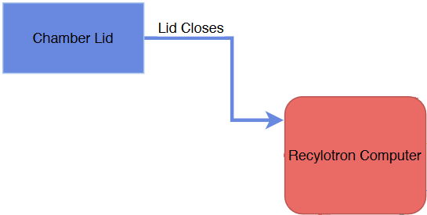
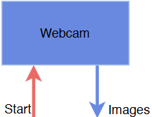
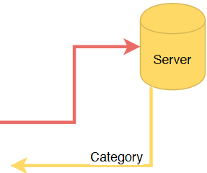
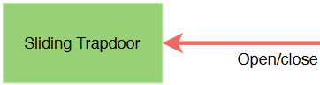
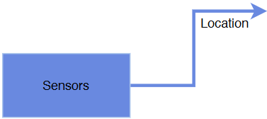
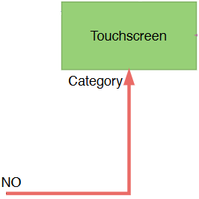
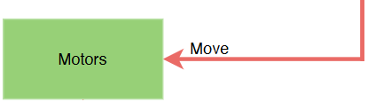
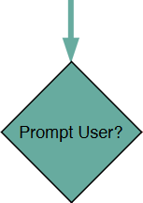
Stop

Slide 9
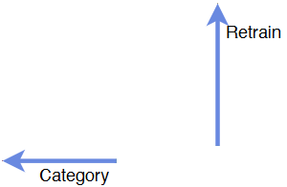
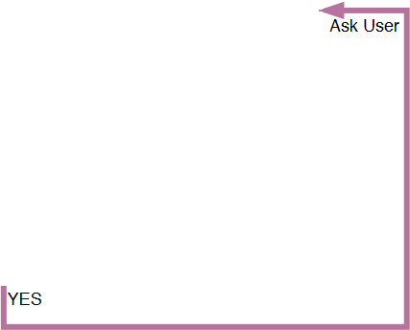
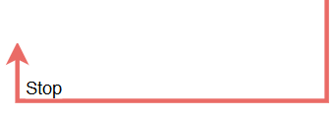

Slide 10
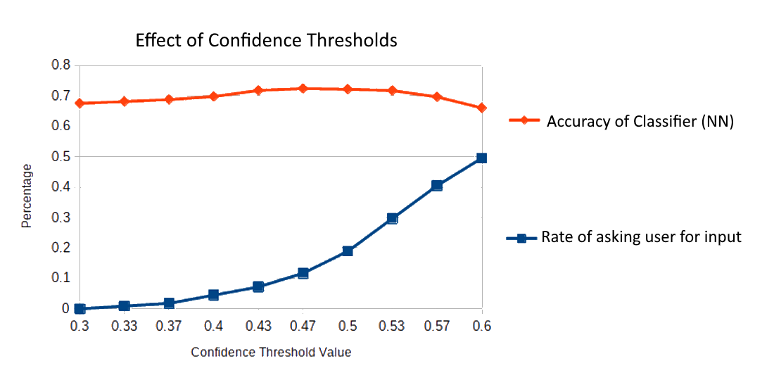

Slide 11
Budget
RED indicates items that were purchased this demo
COMPONENT | COST
Touchscreen | £10
3D Printed Body & Lid | £65
3 Electromagnets | £4
2 Ultrasonic Sensors (GrovePI Kit) | £5
2 Webcams | £15
5 EV3 Motors | £130
2 Steel Railings | £10
Higher End Raspberry PI | £50
Total Cost | £280
Total Spent | £100

